Slide 1

Arabic Dialect Recognition
Omar Elnashar

Slide 2
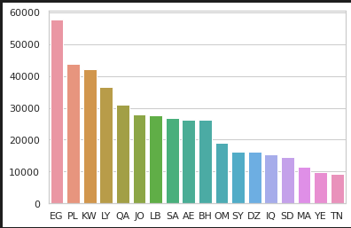
Dataset
18 Dialects
456831 Row
Count of rows for each class

Slide 3
Preprocessing
Remove emojis
Remove hashtags
Remove URLs
Under Sampling the data
Remove Repetition (اهلاااااا -> اهلا)

Slide 4
Models
Linear Support Vector Machine
Multilayer Perceptron
LSTM

Slide 5
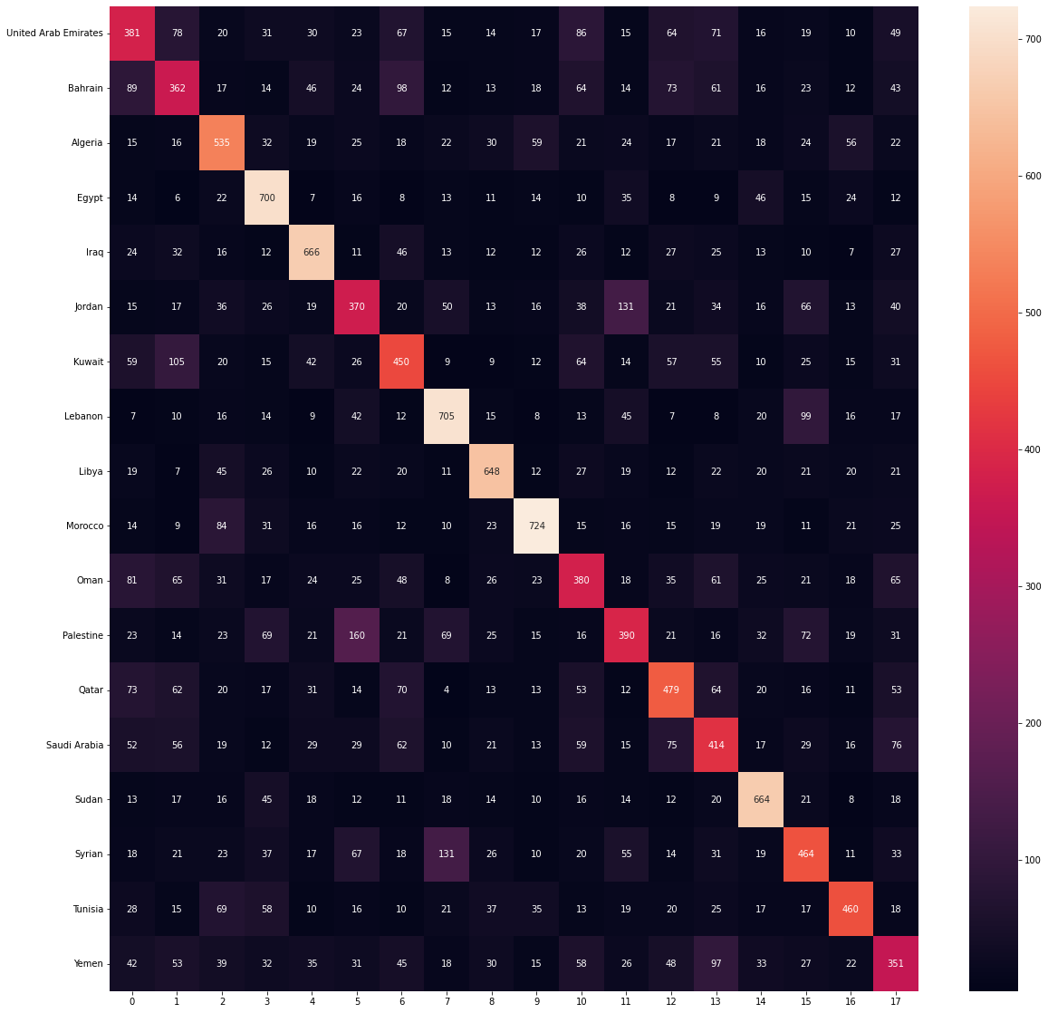
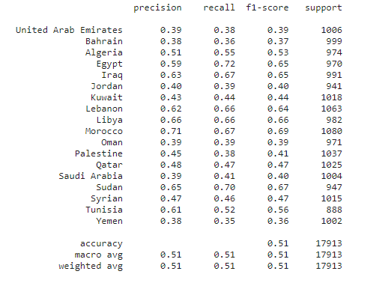
Linear SVM
I used it with TFIDF-transformer with n-gram(2,5)
It achieved a F1-score of 51%

Slide 6
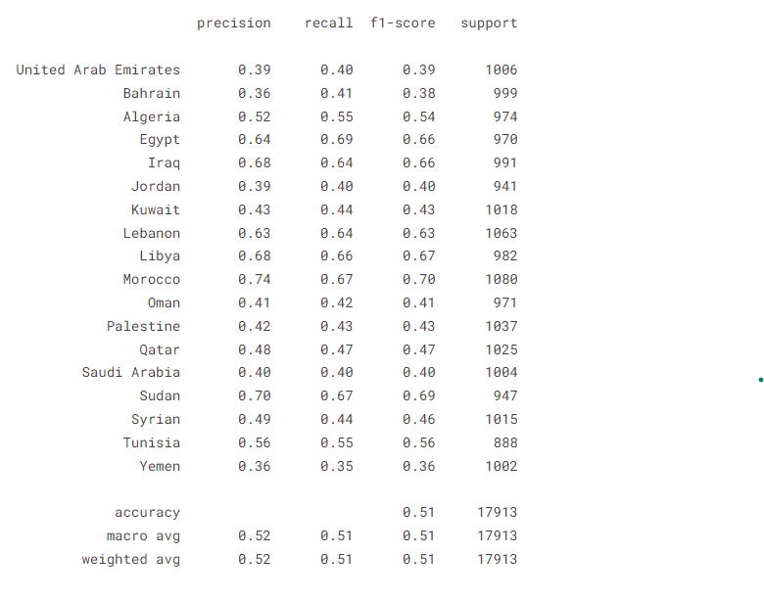
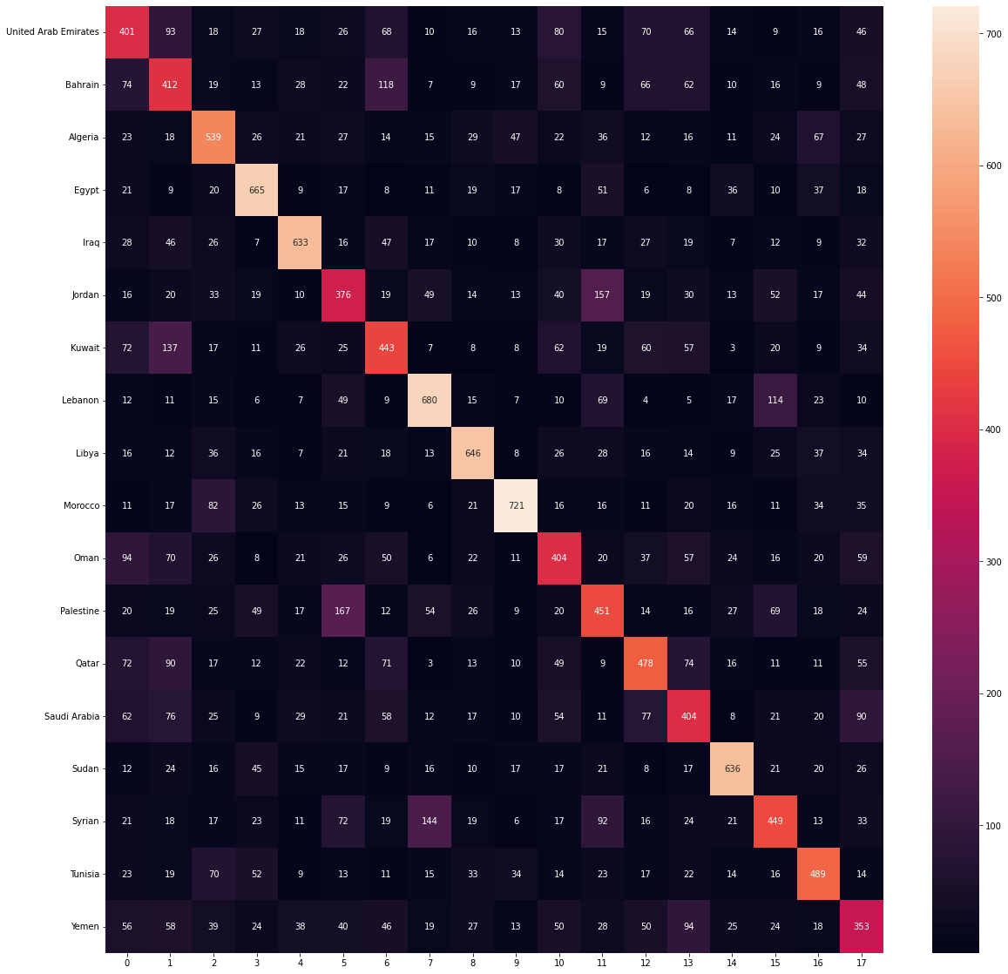
Multilayer Perceptron
I used it with TFIDF-transformer with n-gram(2,5)
It achieved a F1-score of 51%

Slide 7
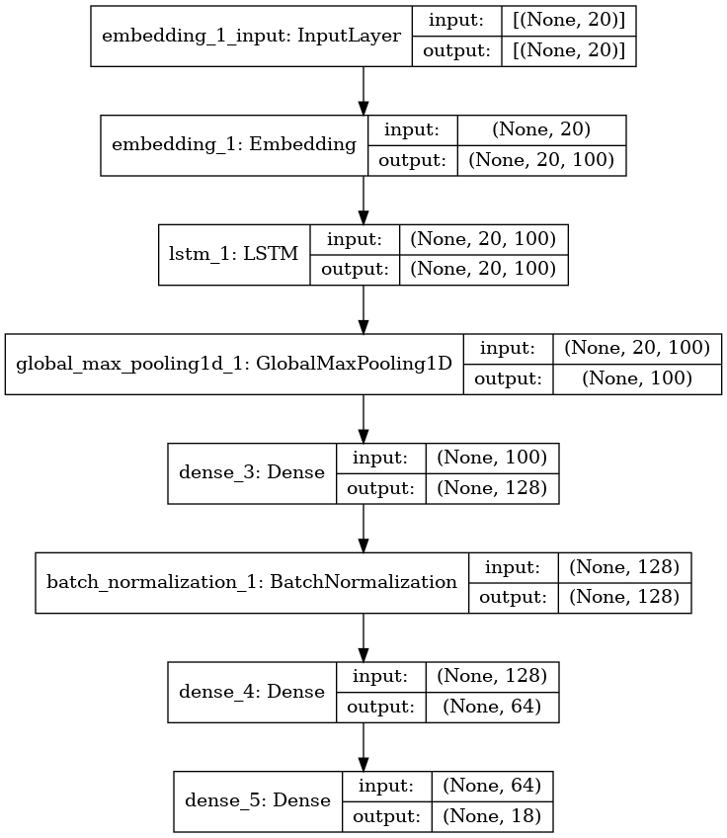
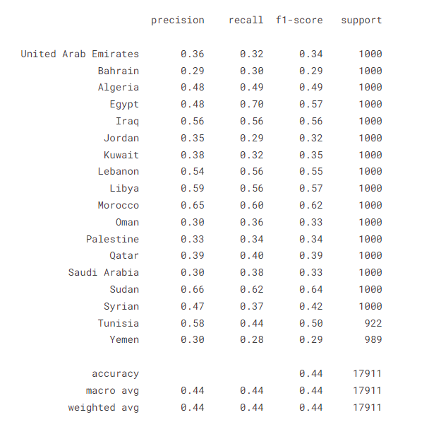
LSTM
We convert text to sequence first
It achieved a F1-score of 51%

Slide 8
Conclusion & Future Work
Models needs more data in some dialects such as Yamen , Tunisia ,…
The Winner Model was SVM
I think one of the most Challenges in this problem is that the high similarity between more than one dialect such as (Egypt , Sudan) ,(Saudi Arabia ,UAE , Qatar), (Tunisia , Morocco) so the model is confused between them .

